Slide 1
THE SERVICE SECTOR AND THE SEMI-PERIPHERY/PERIPHERY

Slide 2
Recall: most jobs today in the core are service-sector jobs. Will these follow the manufacturing jobs? Somewhat, but eventually service sector expands as manufacturing contracts in terms of employment (recall Clark’s model) (e.g. China, see Figure 1).
Many of these are not that mobile: particularly personal services
But some producer services are: particularly ones that can be conducted through telecommunications and telecommuting (everything from call centers/consumer advice to physicians reading MRI scans and X-rays and lawyers doing research). Some evidence that peaked in $ value in 2004.
Some producer service jobs do follow manufacturing jobs.

Slide 3
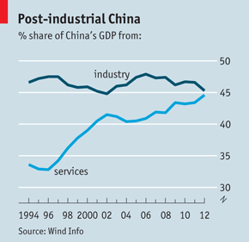
Figure 1: China will probably follow the historic pattern

Slide 4


Slide 5
Off-Shoring White Collar Jobs
Incentives for off-shoring:
1. Labor-intensive producer services (call centers, back-office work, health services, etc.) (Figures 2-6)
2. Tax advantages in havens/low-tax jurisdictions (e.g. Ireland and Luxembourg in Europe have 12% corporate tax rate compared to 25% in UK) -- attract banks and hedge funds (Figure 7).
3. Specialty local economies in computer programming, etc. (large numbers of engineers who are paid 1/4 of wages of equivalents in the US) – e.g. Bangalore, India (Figure 8).

Slide 6
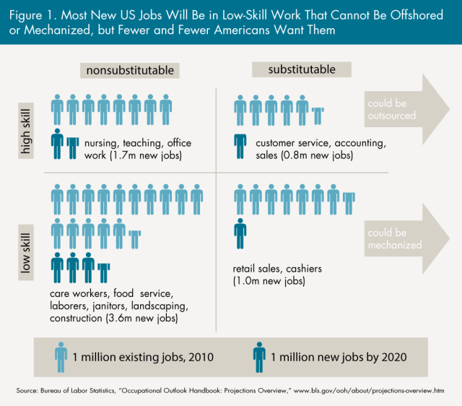
Figure 2: Which service-sector jobs can be offshored?

Slide 7
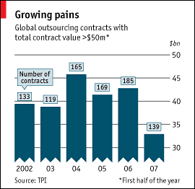
Figure 3: Off-shoring of producer service jobs peaked in $ value in 2004

Slide 8
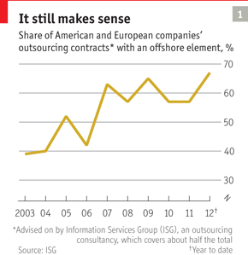
Figure 4

Slide 9
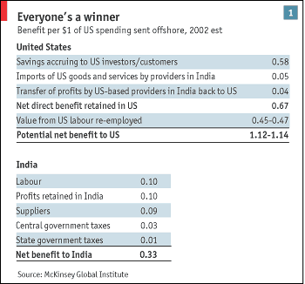
Figure 5: The arithmetic of off-shoring services

Slide 10
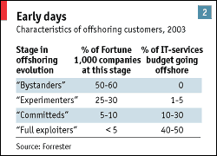
Figure 6: Danger of exaggerating the phenomenon in terms of firm strategy

Slide 11
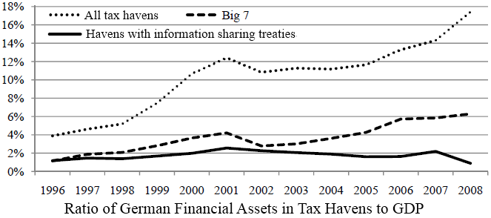
Figure 7: Use of tax havens (many in Europe) removes many banking and hedge fund jobs

Slide 12

“Some day, all these anonymous offshore accounts will belong to shell companies of which you will deny all knowledge.”

Slide 13
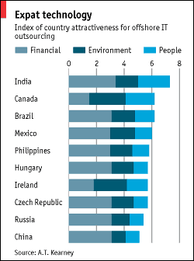
Figure 8: Off-shoring Information Technology out-sourcing

